Slide 1

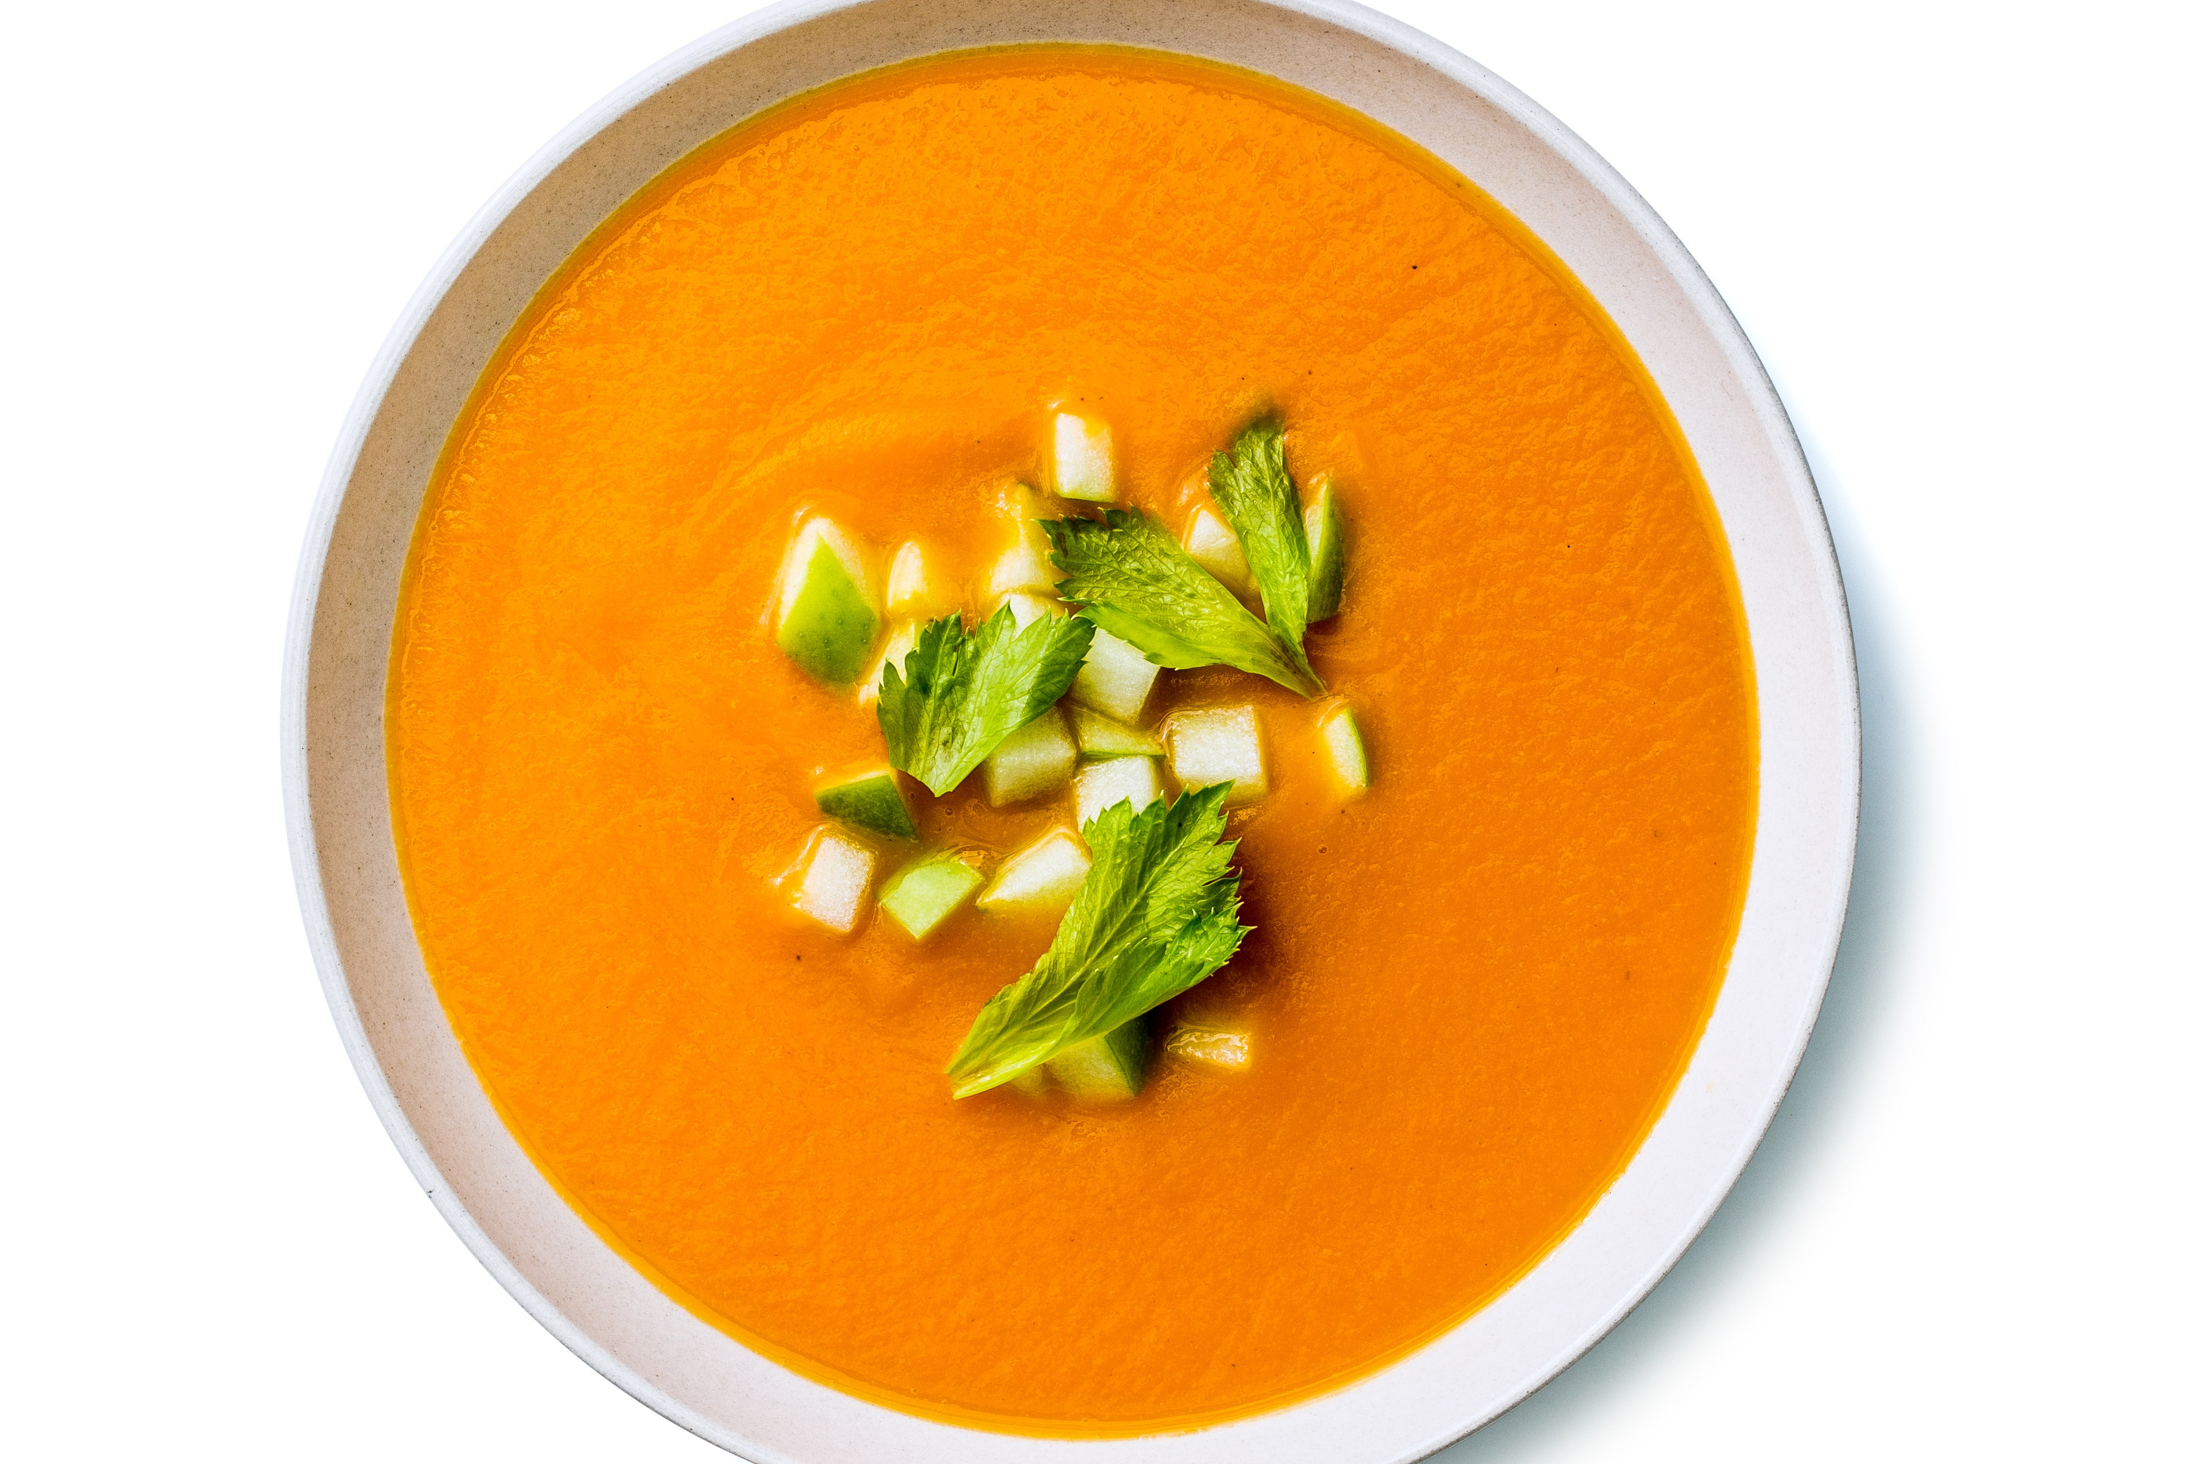
Cream of Tomato with Spring Onion

Slide 2

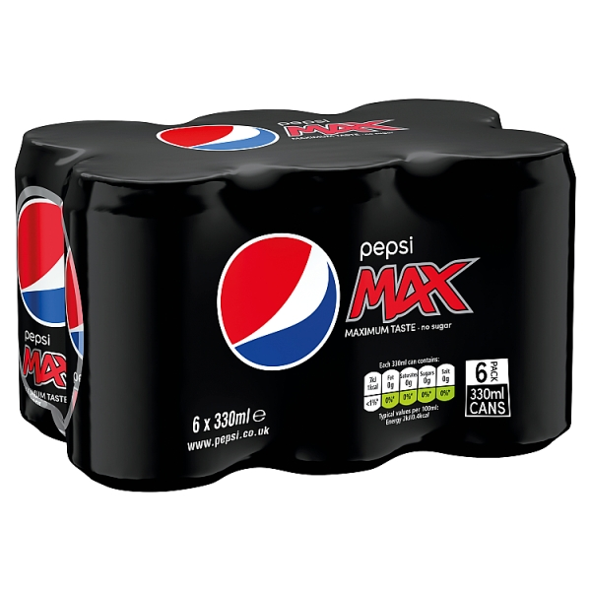
£1.99

Slide 3

SAT 5.30PM
LIVERPOOL
v
CHELSEA
Sports Bar Logo

